Slide 1
Transcending the Technical:
An Examination of Spirituality in Choral Music Making for the Public High School Choral Director
Dr. Jordan Cox
Missouri Baptist University
Notes:
Do you remember why you became a music teacher? What first captivated you about choral singing? Do you remember the experience? What song did you sing, who was the director, etc.?
One participant talked about transcending the technical...

Slide 2
Spirituality
In the literature
Choral Music Education
“To foster and promote choral singing, which will provide artistic, cultural, and spiritual experiences for the participants “ (ACDA, 2017)
Music Education
Conceptual Model of Spirituality in Music Education
(Van der Merwe & Habron, 2015)
Spirituality and Music Education: Perspectives from Three Continents
(June Boyce-Tillman, 2017)
Education
Parker Palmer – “The eternal human yearning to be connected with something larger than our own egos.”
(Teaching with Heart and Soul: Reflections on Spirituality in Teacher Education , 2003)
Spirituality
Breath, Religion, Metaphysical
Notes:
Spirituality – Nursing, Social Sciences, Education
Nursing: Miner-Williams developed a Model of Spirituality in Nursing which led to 6 guidelines that could lead to more holistic, ethical, and balanced patient care
Social Sciences – Holloway and Moss claimed spirituality to be “one of the most significant, important and controversial themes to emerge in social work in recent years”
Brenè Brown – NY Times Bestseller author and researcher from Houston - “recognizing and celebrating that we are all inextricably connected to each other by a power greater than all of us, and that our connection to that power and to one another is grounded in love and compassion” and argues that as a society we are in a spiritual crisis because of an individual’s lack of connection with each other
THREE COMMON THEMES: Breath – many sources reference the term spirituality from the Latin spirare meaning to breathe. This etymology gave way to the understanding that spirituality contributes to the study of the whole person.
Another common theme was the distinction between religion and spirituality. Nearly all the literature distinguishes between the two. Nash says, “Religion is head; spirituality is heart “ Byers shared, ““Religions…are particular answers to the universal human questions about the creation and meaning of life. Spirituality refers to the universal personal concern for the questions” “
And another theme is metaphysical. This is the acknowledgement of “something greater than ourselves” whether that’s God or something else just transcendent.
EDUCATION – Parker Palmer
Music Education – Van der Merwe & Habron – Hermenutical Phenomenological study – 22 primary sources - authors used Van Manen’s lifeworld existentials (corporeality, relationality, spatiality, and temporality) to code the themes that emerged from the literature on spirituality in music education
June Boyce-Tilman – special interest group of the ISME - SAME

Slide 3
Research Question: What does spirituality in the context of choral music making mean to public high school choral conductors?
How do public high school choral conductors experience spirituality in choral rehearsals?
1
How do public high school choral conductors experience spirituality in choral performances?
2
To what extent should public high school choral conductors attempt to infuse spirituality into the choral music making process?
3
How do public high school choral conductors infuse spirituality into the choral music making process?
4
To what extent does the high school choral conductor’s gender play a role related to spirituality as experienced or infused by the conductor in the choral music making process?
5

Slide 4
Method: Phenomenology
Participants
4
Experienced spirituality in choral rehearsal or performance
3
Taught for at least 5 years
2
Member of the American Choral Directors Association
1
Public High School Choral Director – 4 male/4 female

Slide 5
Recruitment
Interview
Analysis
ACDA Facebook Page (14,000 members from the 21,000 total membership)
Demographic Survey (Google Forms)
MO ACDA Facebook Page
Face-to-Face
Zoom
Interview Guide
Transcription
Coding
Simultaneous Data Collection
Expert Panel
Peer Checking
Member Checking
Thick, rich description

Slide 6
Findings
Name (Alias) | Gender | State | Age | Years Teaching | Self- disclosed description | Mode of Interview
Ashley | Female | MO | 31 | 9 | Spiritual & Religious | Face-to- Face
Ben | Male | MO | 29 | 7 | Spiritual & Religious | Face-to- Face
Connor | Male | IA | 29 | 7 | Spiritual, not religious | Zoom
Joy | Female | IL | 33 | 9 | Spiritual & Religious | Zoom
Justin | Male | FL | 31 | 9 | Spiritual & Religious | Zoom
Nathan | Male | MO | 37 | 15 | Spiritual & Religious | Face-to- Face
Sarah | Female | MO | 36 | 13 | Spiritual & Religious | Zoom
Tia | Female | MO | 49 | 27 | Spiritual & Religious | Face-to- Face
Participant Demographics

Slide 7
Theme 1
Theme 2
Theme 3
Theme 4
Theme 5
Connection with the text
Interaction
between the teacher and the students
Interaction Among the Students
Religious Experiences
Interaction with the Audience
Notes:
1. Connor referenced a time when his choir sang The Road Home by Stephen Paulus as the closing piece for their concert. The director said they discussed the meaning of the text and also engaged in post-concert reflections of the song. His very religious immigrant students expressed that the text of the song caused them to reflect back to their home.
2. "This is Lauren’s favorite part of the song and she loves this because it reminds her how small she is compared to God and I knew that’s what she was thinking of when I watched her sing that and [accompanied] her. "
3. "We sang terribly, we were all tired, we had had pizza, we were all bawling, it sounded dreadful, but it was like this collective spirit of people coming together and connecting like that "
4. "because that’s what I see choral music as being—for me—it’s my own personal expression of worship…it causes me to worship because it’s a reflection of the beauty of God "
5. Parents – reverting back to connection to music or between musicians and teacher
BEFORE YOU SEE THE LIST - WHAT PIECES HAVE YOU HAD SPIRITUAL EXPERIENCES WITH???

Slide 8
Literature List
Agnus Dei Samuel Barber Amazing Grace Jackson Berkey Ave Maria Franz Biebl Ave verum corpus William Byrd The Awakening Joseph Martin The Cloths of Heaven Rene Clausen Cum Essem Parvulus Richard Burchard Dies Irae W.A. Mozart, arr. Liebergen Earth Song Frank Ticheli Echo Tom Shelton Elijah Rock arr. Moses Hogan Even When He Is Silent Kim Andre Arnesen Frobisher Bay Braeden Ayres He Never Failed Me Yet Ray Robinson I Am Not Yours David Childs
I Loved All Lovely Things Andrea Ramsey
I Sing Because I’m Happy Rollo Dilworth In the Sweet By and By arr. Daniel J. Hall
Indodana Michael Barrett and Ralf Schmitt Lullaby Daniel Elder Majesty and Glory of Your Name Tom Fettke Music in My Mother’s House Stuart Stotts, arr. J. David Moore
Remember (No. 2 from Two Rossetti Songs) Stephen Chatman
Ritmo Dan Davison The Road Home Stephen Paulus Sing Me to Heaven Daniel Gawthrop Sleep Eric Whitacre Sto mi e milo Daniel Hughes Take Me Home arr. Roger Emerson Tell My Father Andrea Ramsey That Ever I Saw Darmon Meader That Which Remains Andrea Ramsey
Notes:
Characteristics of literature

Slide 9
Discussion
1
Rehearsal
2
Performance
3
Extent
4
Infusion
5
Gender
Connection:
Text
Teacher/students
Among students
Religious experience
Connection:
Audience
Ethical
NAfME
Creating the Atmosphere
No Discernable Differences
Notes:
Boundaries – no offense – students to drive conversation
Role of Sacred Music
NAfME - It is the position of the National Association for Music Education that the study and performance of religious music within an educational context is a vital and appropriate part of a comprehensive music education. The omission of sacred music from the school curriculum would result in an incomplete educational experience

Slide 10
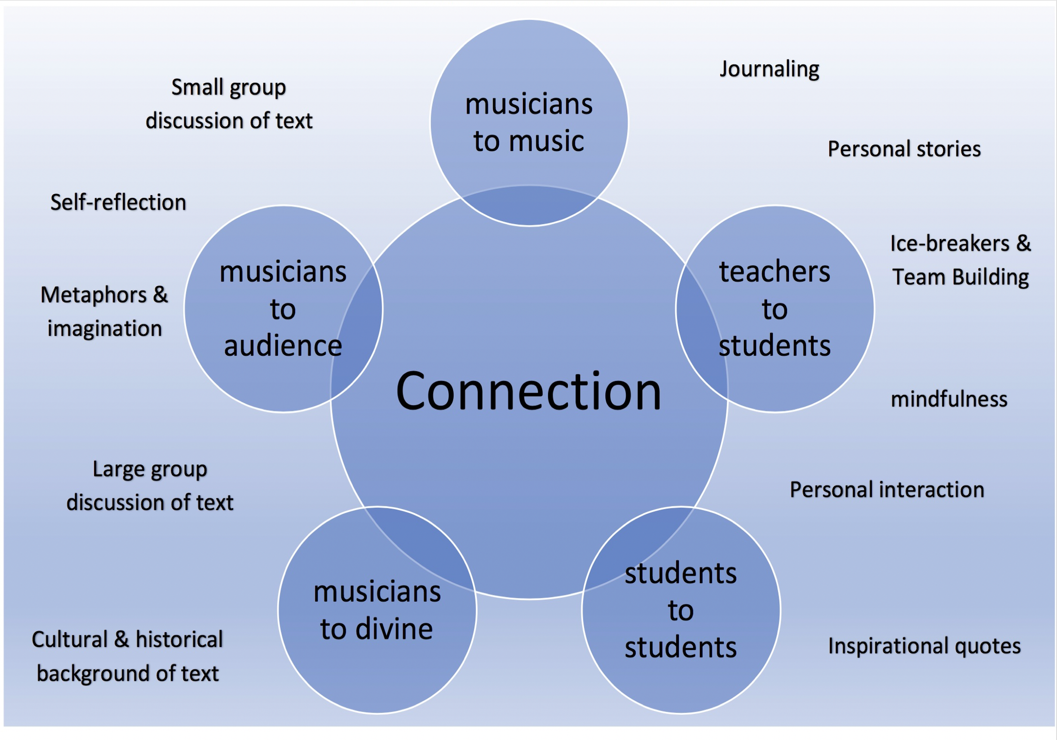
Creating an Atmosphere for Spirituality in Choral Music

Slide 11
Conclusion
For choir directors seeking to help their students experience transcendental moments in their music making, I would recommend the aforementioned strategies.
Implications
This study contributes to the literature on spirituality in music education by providing more insight into understanding spirituality in the choral setting, and by providing practical strategies to create an atmosphere in which spiritual moments could occur.
Contribution
Replicate study to other populations and contexts
Quantifiable data to test strategies
Future Research

Slide 12
Transcending the Technical:
An Examination of Spirituality in Choral Music Making for the Public High School Choral Director
Jordan.Cox@mobap.edu
Missouri Baptist University
Notes:
Thoughts or questions?

