Slide 1
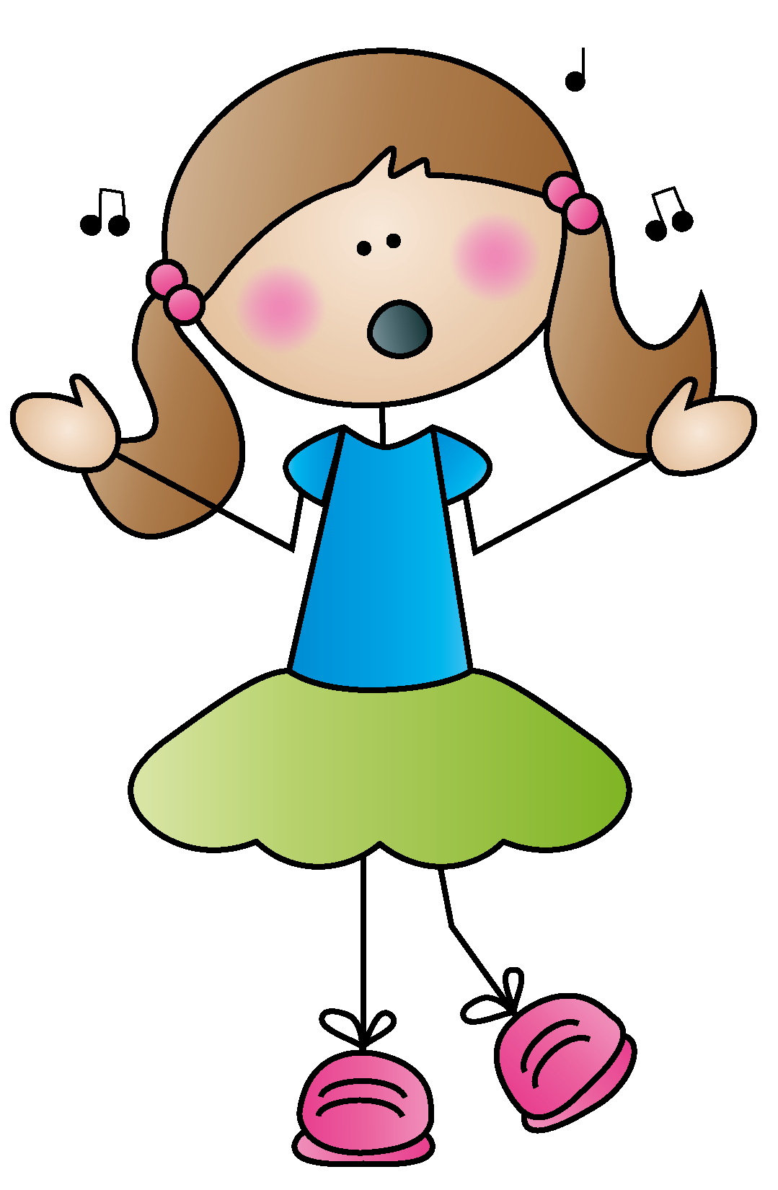
THEY CAN ALL SING:
Developing That Beautiful Primary Head Voice
Presented by Karen Stafford
Missouri Music Educators District 7
August 21, 2021 kstaff1@charter.net

Slide 2
Hello Song
Add some Yoohoos to your hello song if you sing names.

Slide 3
Puppets, Props, and Pretty Little Things
Toby-Doo Music (works with pop-up puppet or puppet behind your back) Cheer if they sing!
Yodeling Goat-Can find used on Ebay
Throw scarf in the air
Hoberman Sphere
Sound tubes

Slide 4
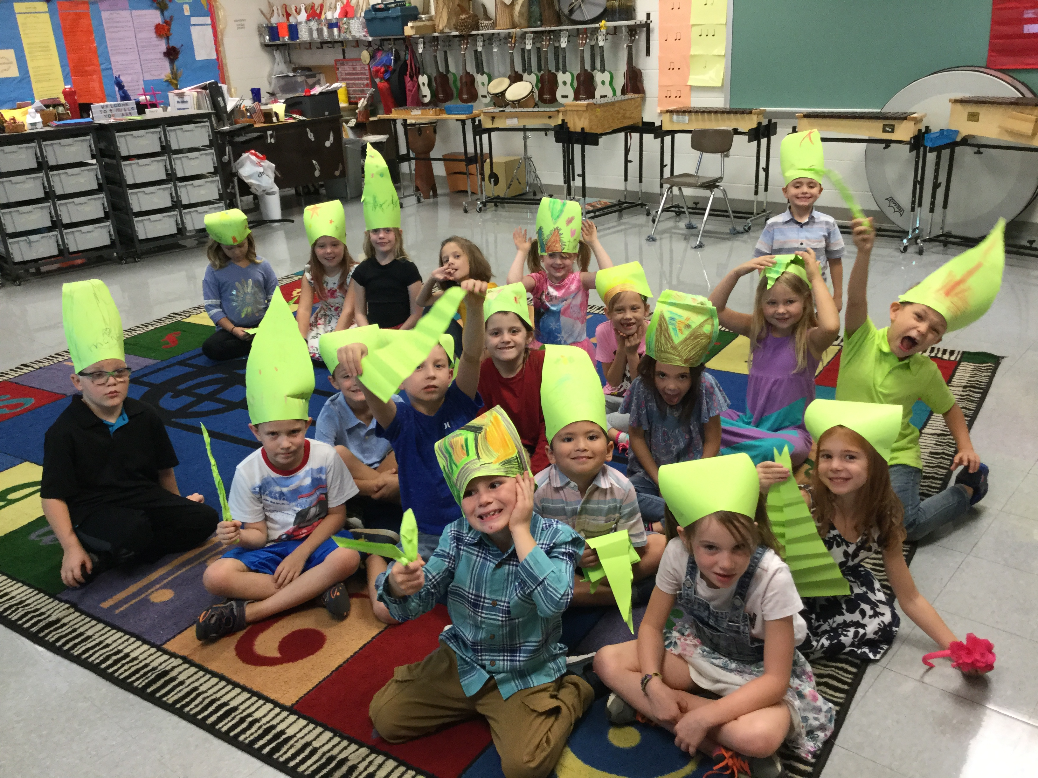
Introducing Mozart, the Marvelous Mouth Magician

Slide 5
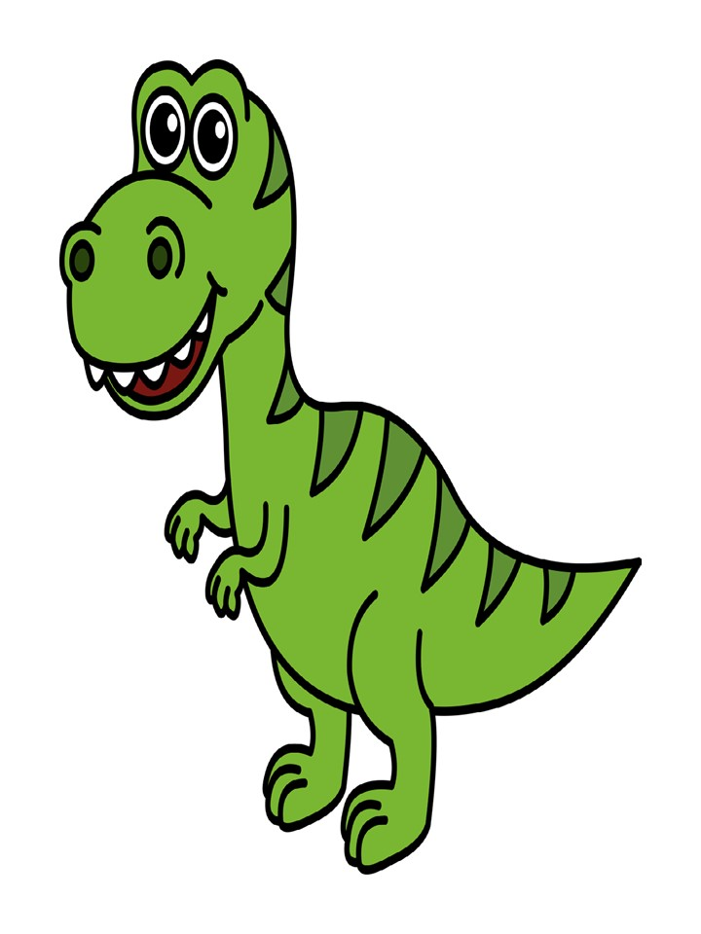
There’s a Dino in the Music Room!

Slide 6
Parachutes!
Parachute Activity: The Killavil Jig by P.J. Hayes, Martin Hayes
Use to introduce music of Irish culture AND to add some “Whoos” into the music, following the parachute. It’s fun if you include a stuffed leprechaun or green Beanie on the parachute.
15 counts: washing machine move side to side with parachute. On count 16, parachute pops up and everyone says “Whooo!” Repeat all Step One.
Skip with parachute counterclockwise 15 counts. Stop and repeat “Whoo” segment. Repeat, going clockwise.
Repeat all of Part One.
Repeat all of Part Two.
Pop the parachute up and down for 15 counts, trying to keep the toy on, and say “Whoo” on 16. Repeat.
For 32 counts, play color switch (i.e., greens and yellows, etc).
Repeat number 2
Hop for 15 counts, pop up parachute on 16 and say “Whoo”. Repeat and let go of the parachute.
Music

Slide 7
Wonky Donkey!

Slide 8
Too Cool for School?
THE CHANGING VOICE
Why Does Your Voice Change As You Get Older? Vocal Folds During Singing Vocal Folds During Vocal Fry

Slide 9
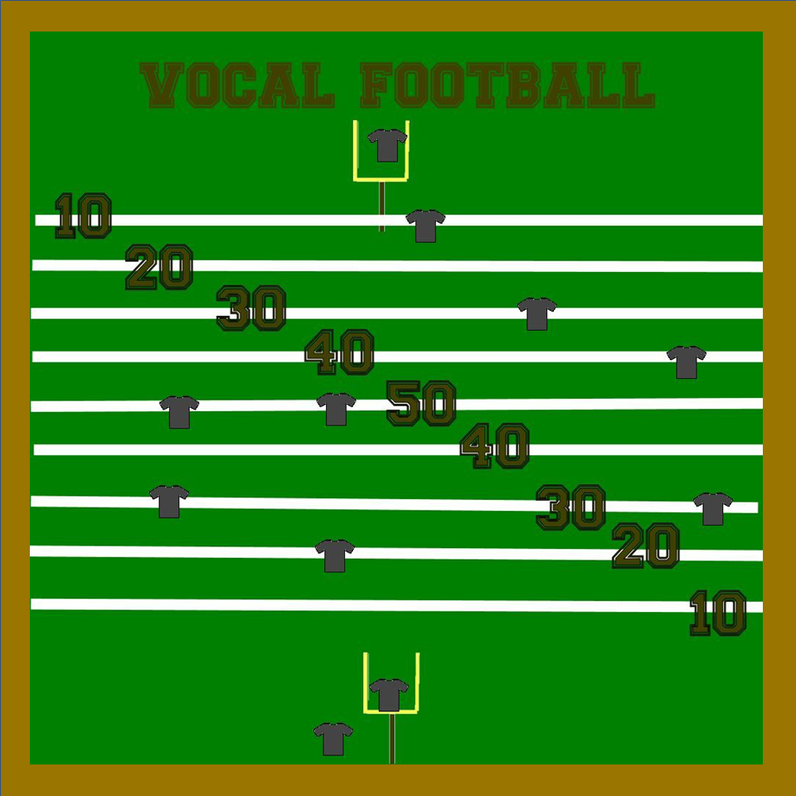
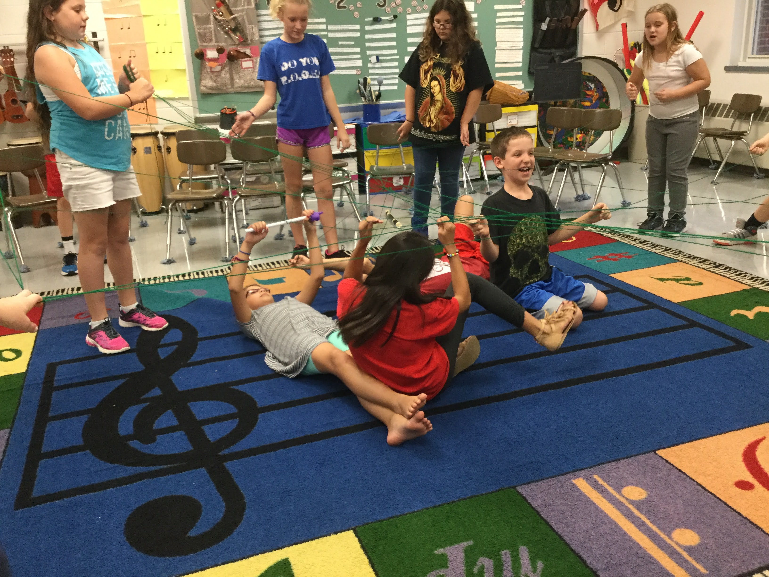
Too Cool for School? Throw in a Little Competition

Slide 10
Simple Harmony for Reluctant/Voice-Changing Singers

Slide 11
Questions? Shared Experiences

