Slide 1
CREATIVITYFIRST
Reframing our priorities
for a better band program
David Wacyk, DMA
Director of Instrumental Activities
Assistant Professor of Music
Notes:
Introduce self, history in the band room
Last time you felt like a creative, artistic professional?
Idea: comes from my transition from teaching HS to teach College- ended up filling my time with all of the non-musical parts of the job. Mainly from a place of needless worry or anxiety about populating my ensembles, over communicating with parents and admin, creating and double checkin inventories, etc…
Placed as a Roadblock to creative work

Slide 2
TABLE OF CONTENTS
01
02
The Topic
The Thesis
03
04
The Strategy
Comments/Questions
What is creativity and why it matters
Everything we do should support music-making.
How to get closer to this mindset
Share helpful thoughts if you want to.
Notes:
Read above

Slide 3
01
the topic
What is “creativity” in our job?
(and why it matters)

Slide 4
Why I think it matters
More than merely hobbies to keep our sanity.
01
The tasks that fuel the parts of the work that fuel us. or,
The parts of the job that got us INTO the job in the first place.
Notes:
not merely hobbies, which we do to keep our sanity…… although that’s important
the tasks that actually fuel the parts of the work we like- or, the parts of the job that got us INTO the job in the first place

Slide 5
What I mean by “creativity” ?
Programing
Score Study
Piano work
Listening, info gathering
Concertizing
Rehearsal
Planning
Instrument refresh
01
Notes:
This is my list- we might all have different lists, but I suggest this as a standard list of what we as band directors DO. These are the creative tasks in our work.
As band directors, we have a habit of relegating This list of creative tasks into a category of “things to maybe get to”. (CLICK ) Mostly because we place every other task into a “get done first” category. Thus, relegating ourselves into non-creative administrators of people who hold instruments. Every day!

Slide 6
Programing
Score Study
What does he mean by “creativity” ?
Concertizing
Rehearsal
Planning
Instrument refreshing
Listening, info gathering
Would love to but…
Get done first.
Answering Email
Moving Chairs and stands
Budget
Inventories
Recruiting
Student Drama
Administration
Parents/boosters
Drinking enough water
Notes:
This is my list- we might all have different lists, but I suggest this as a standard list of what we as band directors DO. These are the creative tasks in our work.
As band directors, we have a habit of relegating This list of creative tasks into a category of “things to maybe get to”. (CLICK ) Mostly because we place every other task into a “get done first” category. Thus, relegating ourselves into non-creative administrators of people who hold instruments. Every day!
SIDE NOTE: We should strive to do these things at work, because it’s work. Don’t program, or score study on your winter/summer break (of course you need to but…) those are your breaks from work. Your job is to do creative things, because that’s what you want it to be. So let’s get into it.

Slide 7
02
the thesis
The Creative aspects of our job must be our priority

Slide 8
The thesis
Music making should be our Primary Motivation
02
Better for us
Better for our students musicians
Our time is limited. Treat it creatively.

Slide 9
Music-making should be
01
better for us
02
Matches our skillset
Something we can (almost) control
Reorients our mindset
Fill your cup
better for them
Our PRIMARY
motivation
- Management tool
- They prioritize what you prioritize
- Rehearsals can be (SHOULD BE) creative activities
Notes:
So let’s talk about these two columns. (Go through thoughts on Better for us, Better for them)
f
OF course, time is a major factor, and we will get into that in a bit,
but but we should at least, even if it’s just a thought experiment on a Saturday morning, start from the perspective of someone who agrees that it would be good for us to emphasize the creative aspects of our job, or at the very least, elevate the creative aspects to the same level of importance as where we’ve placed the mundane elements,
(like instrument inventories, what to do with the 30yo bowties in your uniform closet, and how many recruiting visits you need to make this year.)

Slide 10
03
the strategy
AKA “know yourself”

Slide 11
The strategy
The Comprehensive Conductor,
02
what is your job?
and How to be one
Notes:
First we should identify what our job actually is- what it is, and what we want it to be. we started that earlier.
And my suggestion is that we should strive to be comprehensive conductors,
and I’ll share some thoughts on what I try to do to make that happen given the inevitable pull on my time in every direction.

Slide 12
Above all else
(within reason)
Also
what even is your
JOB?
Notes:
SO this comparison chart could be added to, of course. But in a nutshell all of this is our job. What’s not on here is, working with students. In rehearsal, yes, but also in small groups, zero hour, etc…
But remember, our effort to prioritize the creative aspects of out job is for them. Yes, it’s clearly for us, but if we can Flip the Narrative (CLICK) a bit on these lists, it will have a direct impact on our students in more ways than one.
For our program to work, we need to do ALL of this and more. But for it to work for us, we really need to prioritize the creative aspects of the work. I encourage you to think of yourself as a conductor who leads students in making music. The column on the left are the tasks that lead to that. The column on the right is all necessary to support the column on the left.
This might be a small mindset change, but it’s meaningful. Because if we don’t remeind ourselves of this on a regular basis, our job becomes exactly the opposite. All of the stuff on the right begins to overshadow the left column, to the point where you might go days/weeks without doing your actual job.

Slide 13
Programing
Score Study
Piano work
Listening/ info gathering
Concertizing
Rehearsal
Planning
Instrument refresh
(knowing the instruments)
Be a Comprehensive Conductor
Conducting
Notes:
So we might need to redefine or reframe ourselves (on a regular basis) as a Comprehensive Conductor. Let’s focus in on this list again. (again, this is mine, but as a professional Band Director, I hope yours is roughly similar, because this is the job. I squeezed another one it: conducting.
When I think of the term, “Conductor”, I don’t just picture waiving my arms. That is just one (very important) aspect of conducting. I actually picture all of these tasks wrapped into the term “conductor”. And again, this is what I want to be, for myself, for my band, for my students. So, I need to figure out a way to be this comprehensive conductor,

Slide 14
Our time is limited, so
01
The real challenge
02
The real truth
-Time is finite
-we have to choose tasks
-you’ll get fired if you ignore your principle’s email
-choose small amounts of creative tasks in necessary
-we all stink at this.
Treat it creatively!
-we can try to not stink at this, a little at a time
Notes:
So it’s all fine and good to want to BE a comprehensive conductor, and elevate that work over other work, but our time is just limited. There is never going to be more time available, and even if we COULD create more time, would we fill it with the creative stuff? Or would we just backfill it with more ”get other stuff done first” stuff.

Slide 15
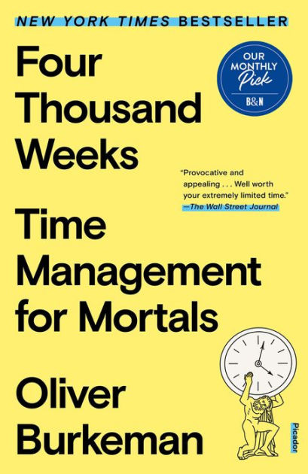
Notes:
Basically a time management book that proves how time-management is an impossible task.

Slide 16
“Every decision to use a portion of time on anything represents the sacrifice of all the other ways in which you could have spent that time, but didn’t’- and to willingly make that sacrifice is to take a stand, without reservation, on what matters most to you.

Slide 17
- Oliver Burkeman
“If you try to find time for your most valued activities by first dealing with all the other important demands on your time, in the hope that there’ll be some left over at the end, you’ll be disappointed. So if a certain activity really matters to you- a creative project, say- the only way to be sure it will happen is to do some of it today, no matter how little, and no matter how many other genuinely big tasks may be begging for your attention.”

Slide 18
Be efficient in your creativity.
Score study
Rehearsal Planning
Programing
Conducting
01
03
While you score-study
Forest and Trees
Woodshedding can still be musical
Bite-size chunks/ phrase diagrams
Forest and trees
Part assignments
Peaceful with coffee?
02
04
Concertizing
Rep List creation
Collaboration with colleagues
While you score-study
Conduct how you want it to sound
Don’t conduct
Notes:
Any amount is great.
KNOW THYSELF find ways to wrap score study into your day
If you only have 5 minutes, make it score study
Score study/diagrams are not your professor's assignment. It's your creative fun.

Slide 19
Quick reminders on Score study
Knowing the score makes you a better conductor
Forest
A diagram helps
Trees
-Melody
-Key or key area
-overall form
- General meaning
-melodic content (including supporting roles)
-Pitch content (scales, fragments)
-form of each subsection
-lays out the whole piece on a single page
-easier to absorb quickly when you study the score
-
-helps you understand what to give your attention to from the podium.
Notes:
This is really basic stuff, but we ALL need constant reminders that KNOWING the music is the only way to teach it. Try your best to reject the “I already know it better than the students do” mentality- Of course you do- that’s the basic expectation of your job. Know it better each time you rehearse it- take 5 minutes and beef up your diagram.

Slide 20
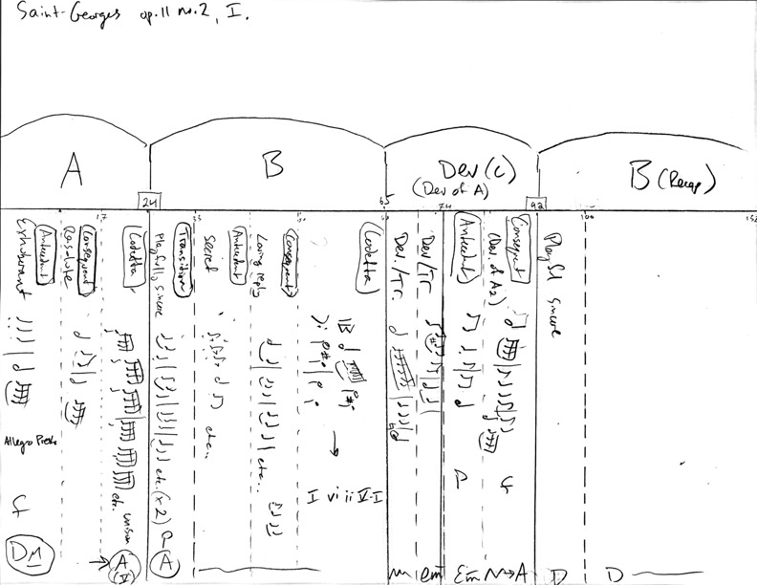

Slide 21
04
Wrap-up
Comments/Questions?
Notes:
So this… quick reminder- not a scolding, not even a challenge,
but a reminder that you are a creative person- you create music, create a love of music in your students, a love of band,
We need daily reminders for ourselves to be that comprehensive conductor, otherwise we lose those skills, and even our interest in being a conductor, and just start going through the actions of a band director, without much creative thought behind those actions- that’s a disservice to our students.
Questions/comments? Advice for the room?

